Slide 1
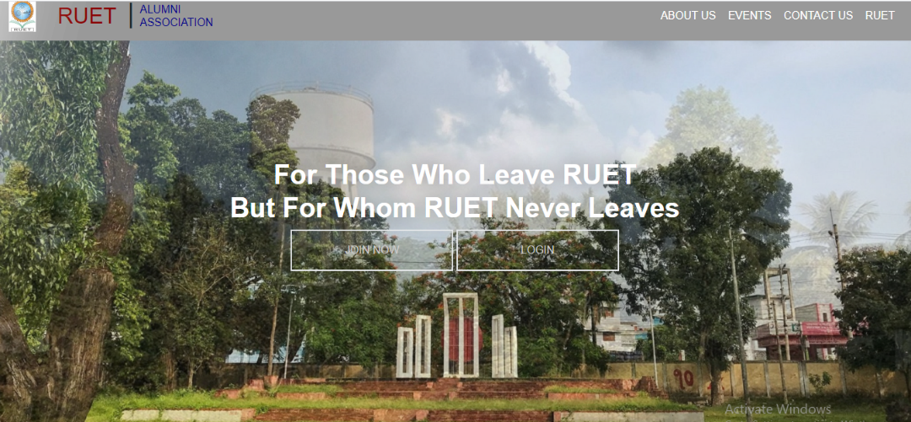
RUET Alumni Association
Features of the RUET Alumni Association Website
Our ex students of RUET can sign up by their name and password and join by using some spacific information.
They can see the current events of RUET
If the students have any message to ask or to say about RUET they can leave it and admin of this website can see it.
They can contact directly to the authority and also can go to RUET website.
If the user want to see the newly joined teacher and if they want to find his seriesmate they can.
What is RUET Alumni Association ?
RUET Alumni Association is a platform where all the former graduates of RUET and running batch students can save their identity and important information for the purpose of mutual communication, queries and bonding.
Equipments needed for the project
Operating System (Windows 10)
Sublime Text as Editor
XAMPP as Hosting server
PHPMyAdmin for using Database
PHP, HTML, CSS,JavaScript etc as the programming languages for Coding and designing stuff.
Zannatul Fedousee
1603060

